Slide 1
Nola Pender Health Promotion Model

Slide 2
Presented By
Sandy Saylor
Jackie Tiefenthal
Michelle Rowe
Chris Bookheimer

Slide 3
Historical Evolution of Health Promotion Theory
First published in 1982
Modified in the late 1980’s
Modified for last time in 1996
Wills, (2007), p. 247
Parsons, (2008), p. 51
Bredow, (2009), p. 294

Slide 4
Metaparadigms
Person
Environment
Health
Nursing

Slide 5
Person refers to
Individuals
Families
Communities

Slide 7
Individual factors include
Biologic
Sociocultural
Psychological

Slide 8
Biologic factors
Age
Body Mass Index
Pubertal status
Menopausal status
Aerobic capacity
Strength
Agility
Balance

Slide 9
Sociocultural factors
Race
Ethnicity
Acculturation
Education
Socioeconomic status

Slide 10
Psychological factors
Self esteem
Self motivation
Perceived health status

Slide 11
Self Efficacy
“Self efficacy is the judgment of personal capability to organize and carry out a particular course of action. Self-efficacy is not concerned with skill one has but with judgments of what one can do with whatever skills one possesses.” – Pender, 2006, p. 53.

Slide 12
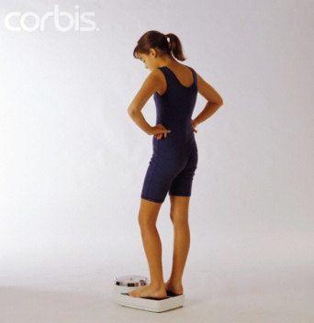
Success Breeds Success
According to Pender, “The most powerful input to self-efficacy is a successful performance of a behavior” (Pender, 2006, p. 59).

Slide 13
Building Healthy Communities
http://www.visittraversecity.com/outdoor-recreation-4/ photo taken from Traverse City Travelers and Convention Bureau

Slide 14
Environment
where a person spends most of time (schools, workplaces)
Nursing centers
Occupational health settings
Community

Slide 15
Environment
“Environmental wellness is manifest in harmony and balance between human beings and their surroundings” (Pender, 2006, p. 9).

Slide 16
Nursing
Health Promotion Services
Health Promoting Interventions
Empowerment for Self Care
Client’s capacity for Self Care

Slide 17
Nursing
“Nurses make age-specific and risk-specific recommendations for clinical preventative services” (Tomey, 2010, p. 435).
“Clinical interest in health behaviors represents a philosophical shift that emphasized the quality of lives alongside the saving of lives” (Tomey, p. 442).
Nurses promote wellness by health promotion education (Tomey, p. 442).

Slide 19
health
This model promotes the pursuit of health through out the life span (Pender, 2006 p. 282).
Subscales: “health responsibility, physical activity, nutrition, interpersonal relations, spiritual growth and stress management” (Tomey, 2010, p. 441).

Slide 20
Concepts Unique To Model
“Unlike avoidance-oriented models that rely upon fear or threat to health as motivation for health behavior, the HPM has a competence or approach-oriented focus (Pender, 1996). Health promotion is motivated by the desire to enhance well being and to actualize human potential (Pender, 1996).”
The HPM is a borrowed theory
Tomey, p. 441

Slide 21
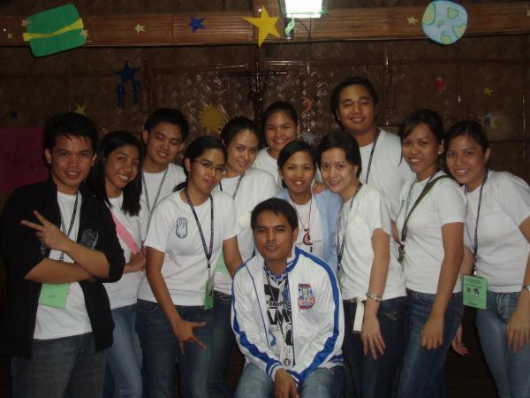
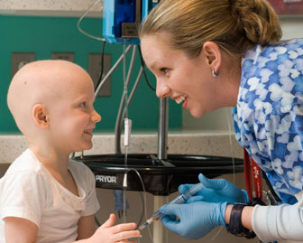
How Pender’s HPM can be used in clinical practice
Applies across a lifespan
Useful in a variety of settings
Holistic
Unique plans
Educating/hands-on

Slide 22
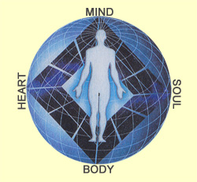
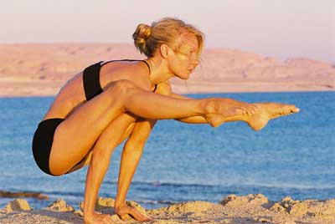
HPM: Framework for patient assessment
Goal’s of HPM
Improved health (holistically)
Enhanced functional ability
Better quality of life at every stage
Increased well-being
Possess a positive dynamic state

Slide 23
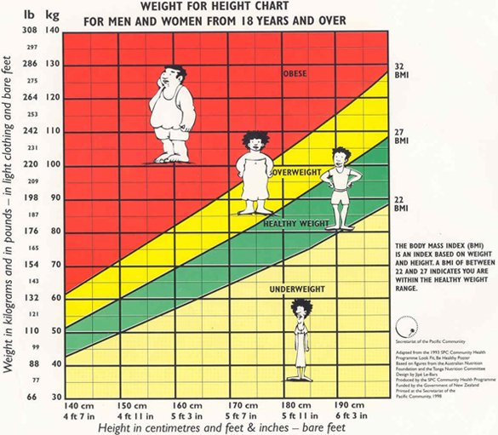
BMI: body mass index is a number calculated from a person’s weight and height. BMI provides a reliable indicator of body fatness for most people and is used to screen for weight categories that may lead to health problems.

Slide 24
A dietary journal will help keep track of everything you consume to give you an idea of what your eating and what you may not realize you’re consuming.

Slide 25
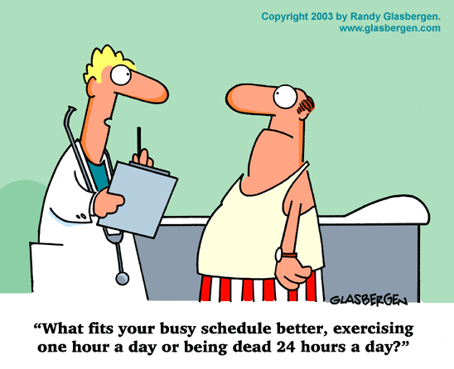
An exercise screening will help identify different types of exercise and physical activity regimens that can be tailored to meet the existing health conditions, illnesses or disabilities of individuals.

Slide 26
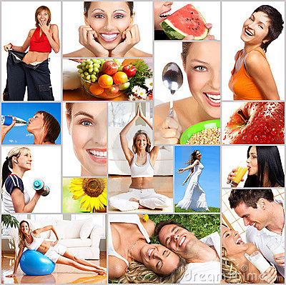
Lifestyle questionnaire: used in showing past/present lifestyle habits that may affect or have affected an individual’s life and how they can make the change to improve their health.

Slide 27
Nursing Education
“…increasingly, the HPM is incorporated in nursing curricula as an aspect of health assessment, community health nursing, and wellness-focused courses” (Tomey, 2010, p. 443).

Slide 28
Current Research Status of Health Promotion Theory
Promoting participation: Evaluation of a health promotion program for low income seniors
Testing the barriers to healthy eating scale
Diet and exercise in low-income culturally diverse middle school students
Early detection of type 2 diabetes among older African Americans
A bicycle safety education program for parents of young children
Effectiveness of a tailored intervention to increase factory workers’ use of hearing protection
An explanatory model of variables influencing health promotion behaviors in smoking and nonsmoking college students
Balanced analgesia after hysterectomy: The effect on outcomes
Promoting the mental health of elderly African Americans: A case illustration
Barriers and facilitators of self-reported physical activity in cardiac patients
Wills, (2007), p. 249

Slide 29
Strengths
Positive emotions or affect is the drive that increases the probability of commitment and action to the desired goal.

Slide 30
Strength
The greater the commitment to a plan of action, the more likely health promoting behaviors are maintained over time.
Making a deal with yourself

Slide 31
Strength
Persons are more likely to commit to and engage in health promoting behaviors when others model the behavior.

Slide 33
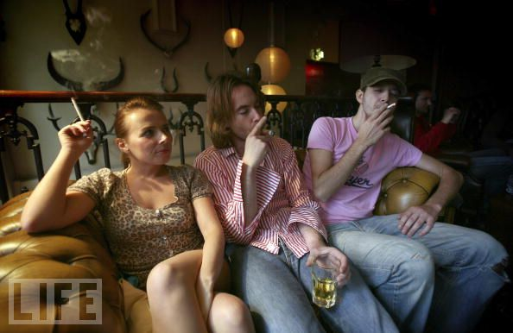
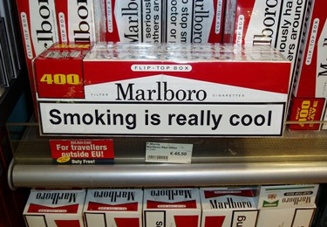
Limitations
Perceived barriers can constrain the commitment to action

Slide 34
Limitation
Commitment to a plan of action is less likely when competing demands over which a person has little control over requires immediate attention.

Slide 36
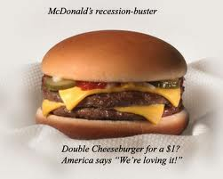
Limitation
Commitment to a plan of action is less likely to result when other actions are more attractive and preferred over target behavior

Slide 37
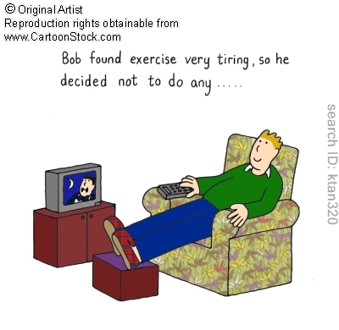

Slide 38
In summary…
“guide nurses in helping clients achieve improved health, enhanced functional ability, and better quality of life” (Bredow, 2009, p. 301).
Model is justified by its ability to account for lifestyle factors and need for “improvements in society” (Bredow, p. 301).
Based on two other theories: expectancy value theory and social cognitive theory.
Model has been widely tested in many settings
Has “exciting possibilities for the creation of interventions that are tailored to the unique characteristics and needs of individual clients” (Bredow, p. 301).

Slide 40
References
Tomey, A. (2010). Nursing theorist and their work. Maryland Heights, MO: Mosby Elsevier.
Pender, N, Murdaugh, C, & Parsons, M. (2006). Health promotion in nursing practice fifth edition. Upper Saddle River, NJ: Pearson Education, Inc.
Peterson, S, & Bredow, T. (2009). Middle range theories application to nursing research second edition. Philadelphia, PA: Wolters Kluwer/Lipincott Williams & .
McEwen, M, & Wills, Evelyn. (2007). Theoretical basis for nursing second edition. Philadelphia, PA: Wolters Kluwer/Lipincott Williams & .
Kearney-Nunnery, R. (2008). Advancing your career concepts of professional nursing. Philadelphia, PA: F.A. Davis Company.

Slide 41
DISCUSSION QUESTIONS
1. After viewing our presentation, can you think of ways that you use the HPM in your nursing practice or personal life? How would you incorporate this model if you do not currently utilize it?
2. According to Middle Range Theories Application to Nursing Research, “application of the HPM is untested in acute care settings and with clients whose health concerns are urgent or living condition are unstable”. Why do you think it would be hard to apply to these situations?
3. BMI, dietary journal, exercise evaluation and lifestyle questionnaire are examples of assessment tools that can be used with the HPM. Can you identify strengths or weaknesses of these or do you use a different assessment that would apply to the HPM?

Slide 42
For Your Viewing Pleasure…
http://www.youtube.com/watch?v=ykz8DhqnWzI
The original pioneer of health promotion!

